Slide 1




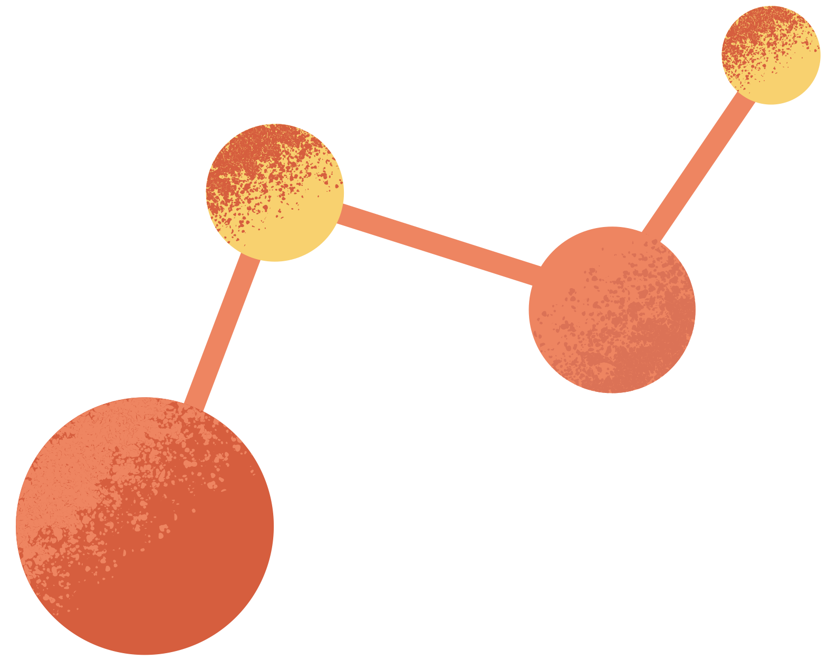
Cyanobacteria and Exopolysaccharide Growth on Martian Biocrust
MARGARET MAYHOOK
NORTHERN ARIZONA UNIVERSITY

Slide 2
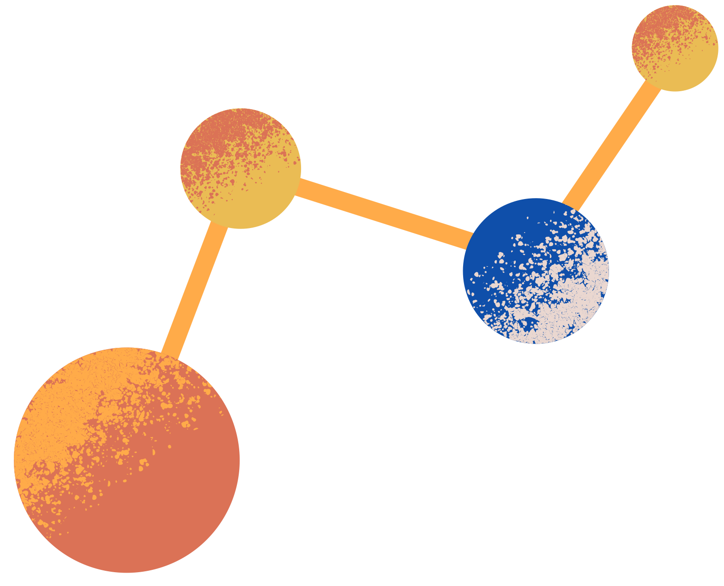
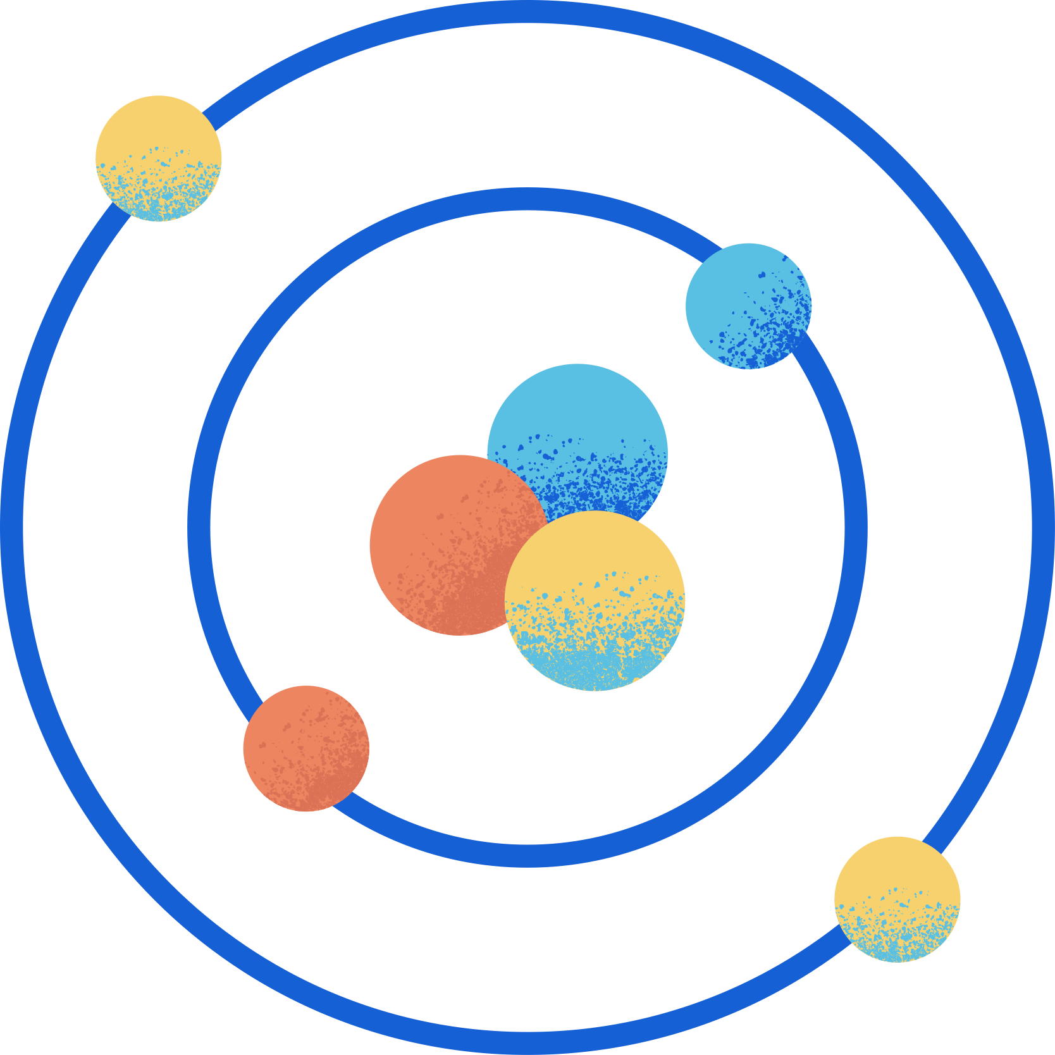
MOTIVATION AND QUESTION
WHAT WE KNOW
Cyanobacteria are one of the first life forms to evolve on Earth (6). They support life by being providing fuel for microorganisms and plants, and oxygen into the atmosphere (8). There is research that may help bring cyanobacteria to Mars (3).
Scientists have been looking for biotic traces on Mars, as well as how to use cyanobacteria if Mars were colonized (3), but have not grown biotic substances in order to see the effect on Martian soil.
QUESTIONS?
Is it possible for cyanobacteria to grow on Mars biocrusts? Are cyanobacteria able to leave exopolysaccharides behind and how much? Do these exopolysaccharides have an effect on the natural geological makeup?

Slide 3
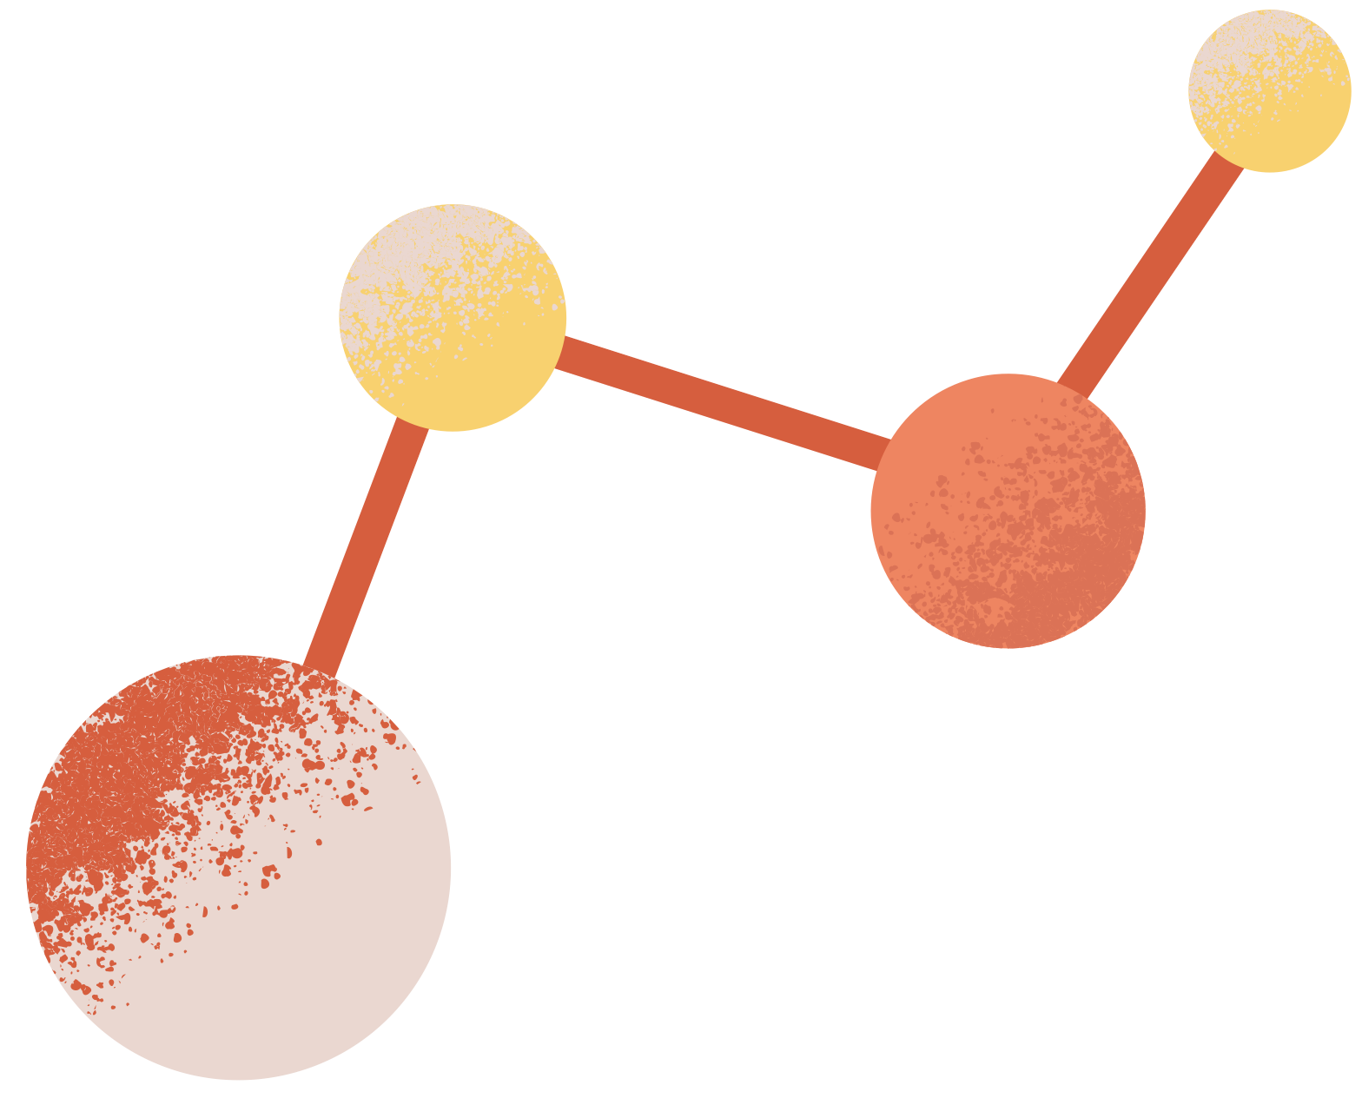
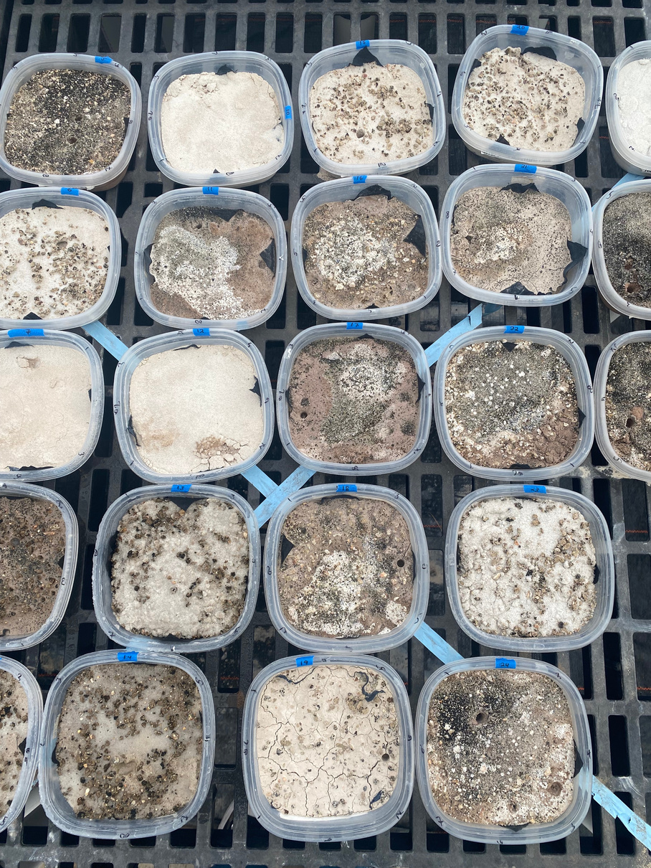
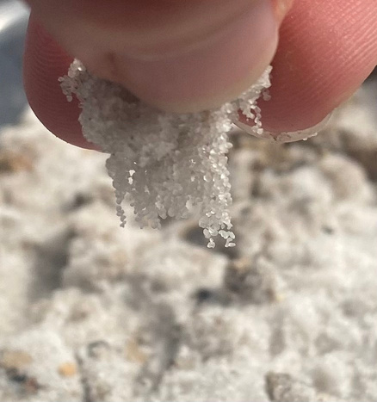
BACKGROUND AND INTRODUCTION
CYANOBACTERIA
EXOPOLYSACCHARIDES
Cyanobacteria are believed to be one of the first organisms on Earth, which are still alive today. They are an important part in evolution because they have a huge part in things like the carbon cycle and oxygen supply (6).
Exopolysaccharides, commonly referred to as EPS, is a stick residue deposited by microbes to help stick sediments, like sand, together. (5)
This provides evidence of biocrusts.
EXPERIMENTAL BIOCRUSTS
We use a variety of biocrusts. Clay and sand biocrust to represent Earth’s biocrust for comparison to the Martian regolith. The number of samples for each category is selected randomly, and we have a control for each type.
HYPOTHESIS
Cyanobacteria will be able to grow on Martian bio crusts and leave EPS behind due to the similar terrain as Earth. There will be more EPS than cyanobacteria found in the inoculated Martian bio crusts because they have more lenient living conditions.
visual observation of EPS found in 100% sand bio crust
bio crusts variety of Mars regolith, clay, and sand in NAU Greenhouse

Slide 4



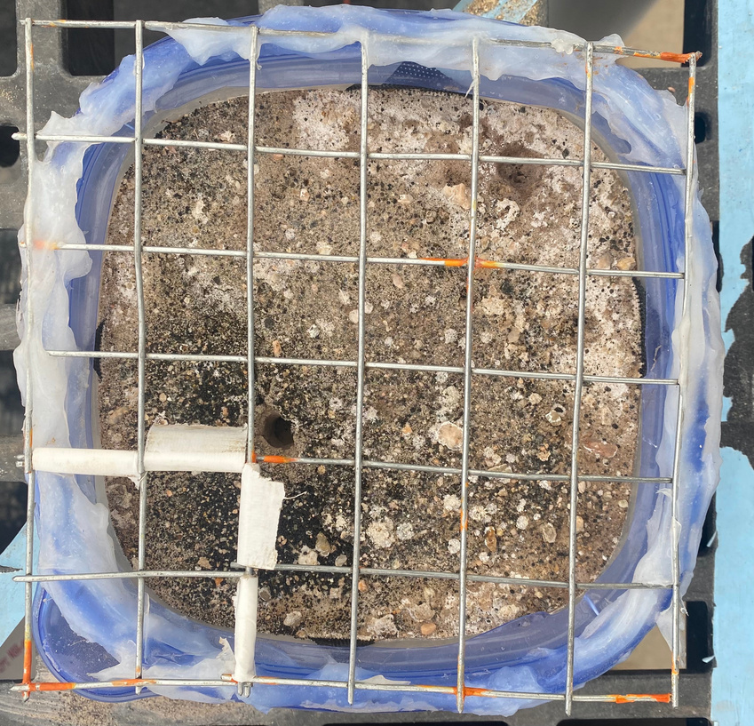
METHODS 1: GREENHOUSE
01
FRAMEWORK
In each tub of biocrust, we separate into 25 sections
in each section we look at what is growing in the bottom left corner, in order to avoid bias
we record the last Friday of each month
02
WATERING
We water after framework each week, or after framework and collecting dry samples at the end of each month.
Each tub gets 0.25 liters of water each week in order to keep bacteria alive
grid used for framework data

Slide 5



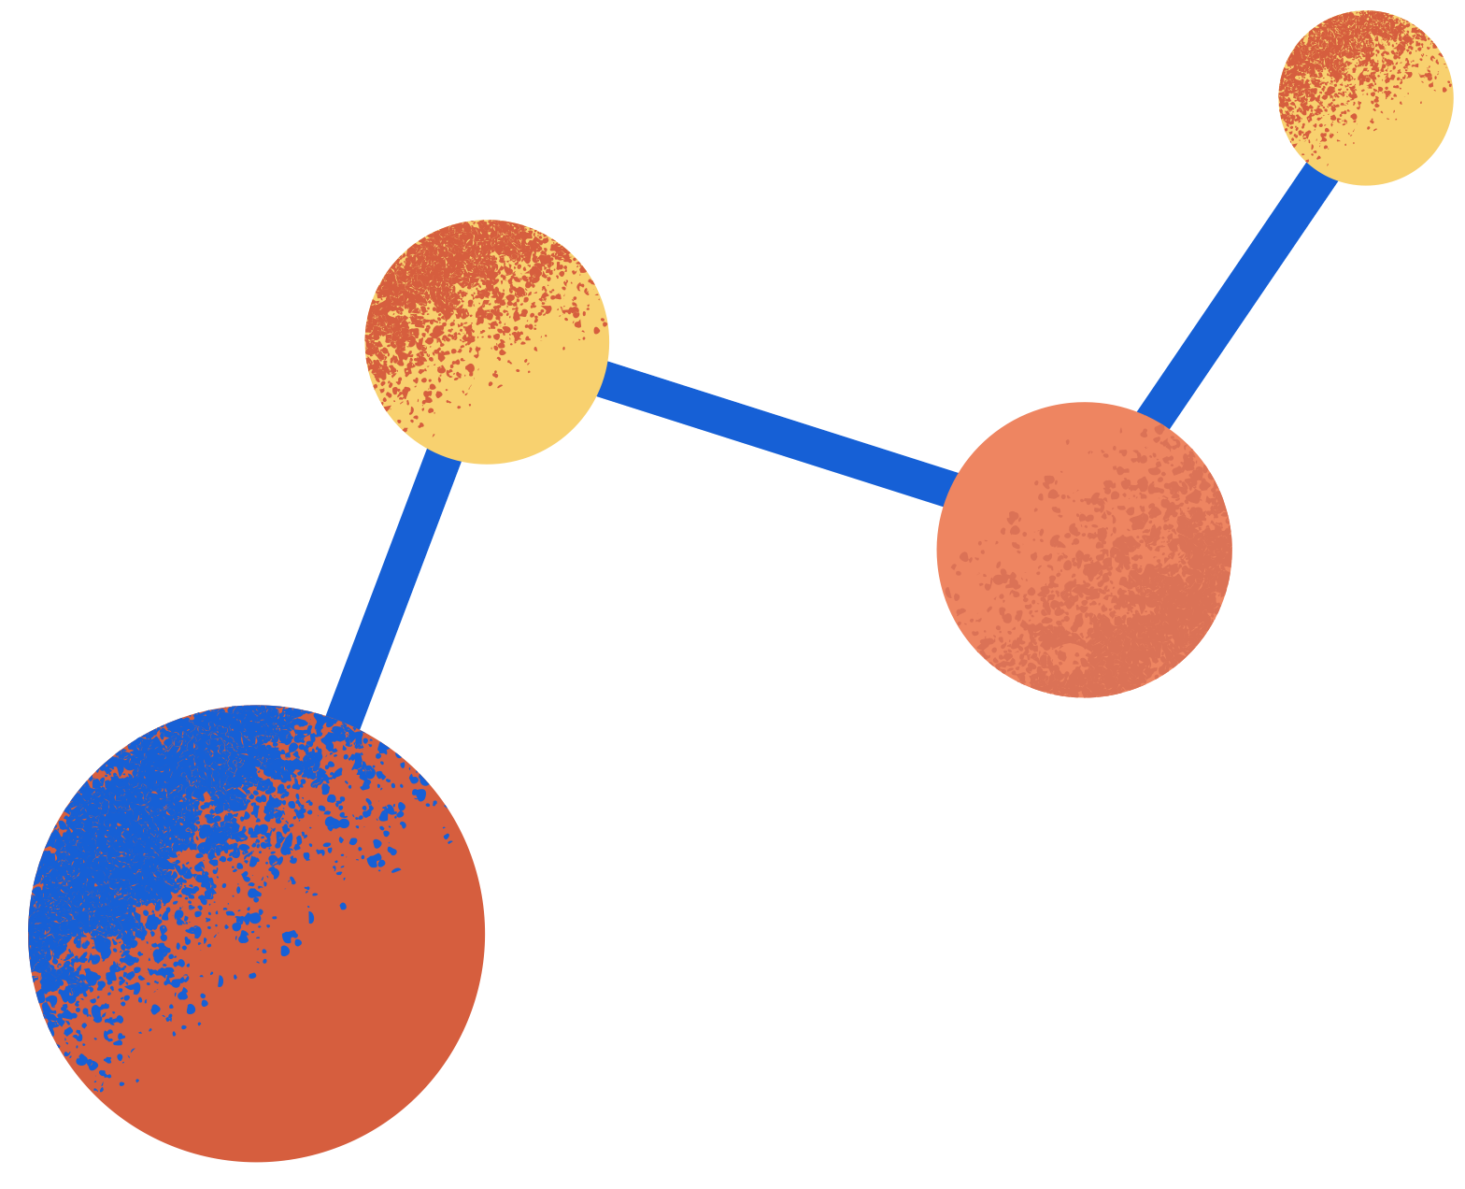
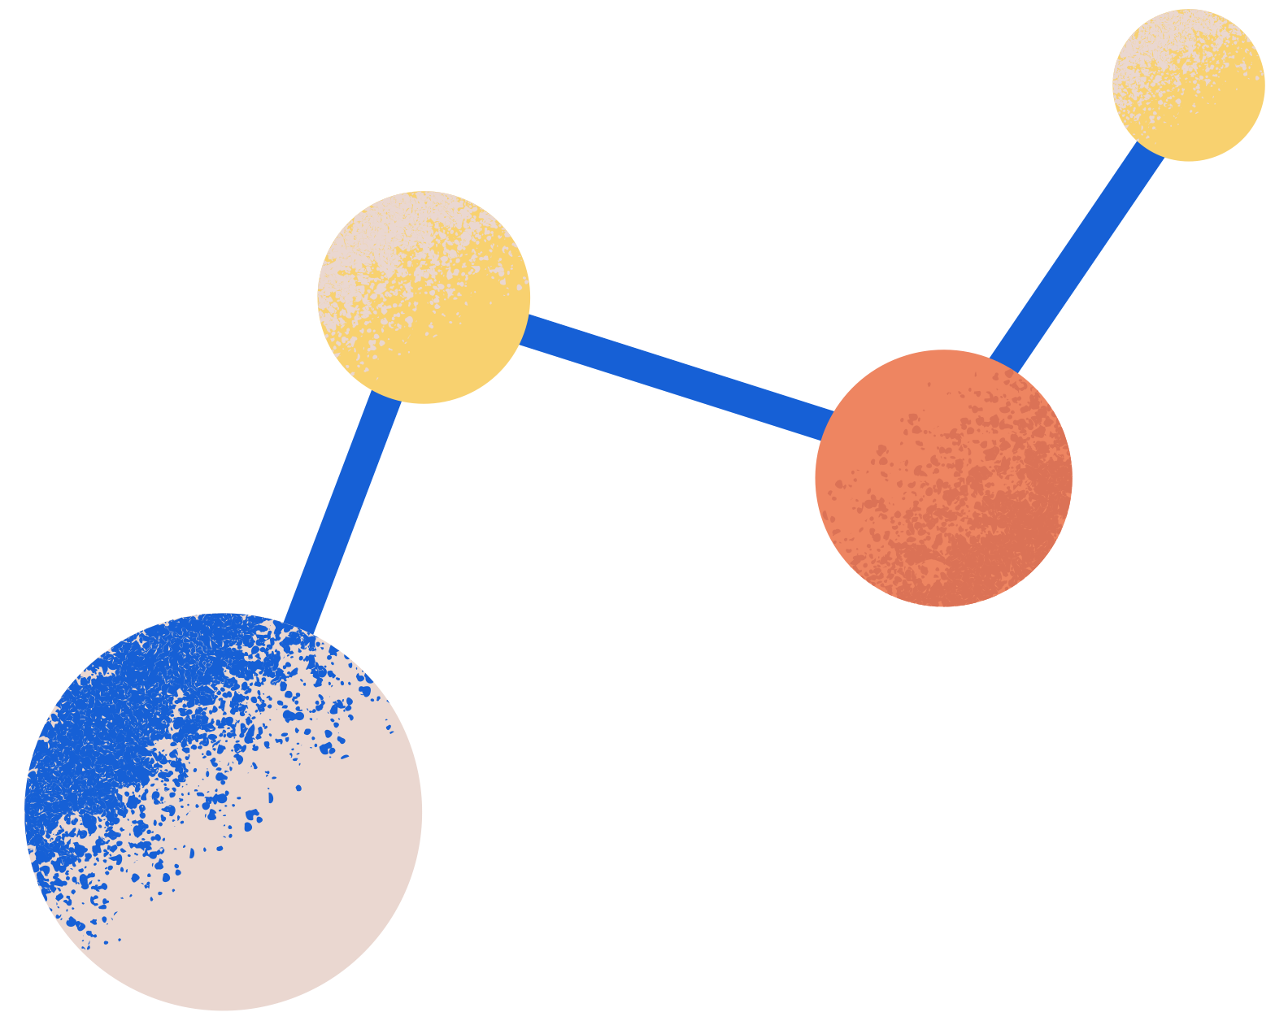
METHODS 2: EXTRACTIONS
03
CHLOROPHYL A (1)
Of the collected soil we separate out 3 grams for Chl A extraction
Samples are kept in a dark freezer to prevent degradation
Representative of amount of cyanobacteria present in the sediment
04
EXOPOLYSACCHARIDES (2)
Of the collected soil we separate out 0.05 grams for EPS extraction
Samples are kept at room temperature to prevent degradation.
Representative of the amount of EPS sticking sediment together in the sample

Slide 6

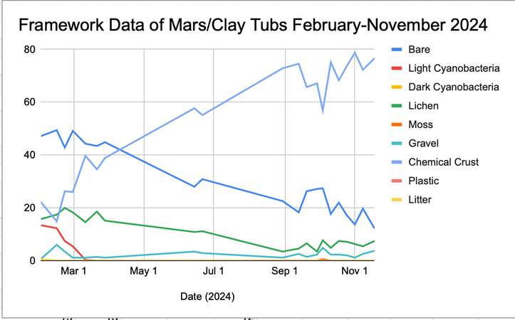
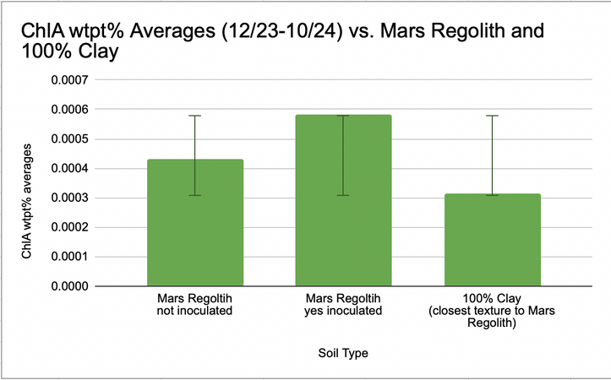
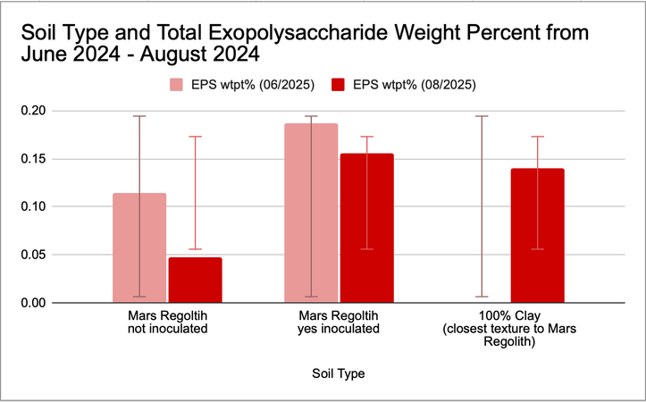
RESULTS
FRAMEWORK
CHL A
EPS

Slide 7

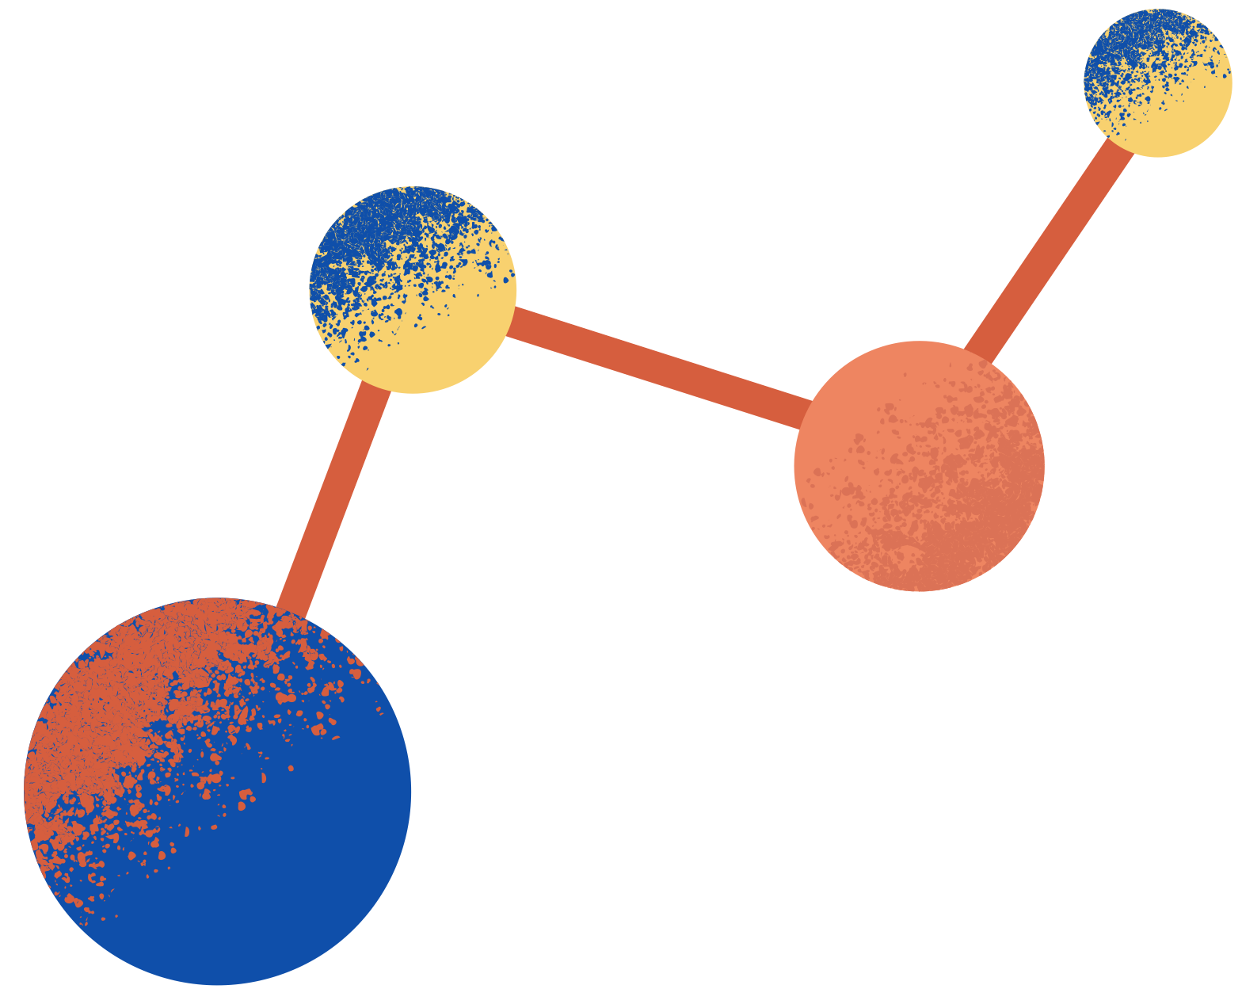
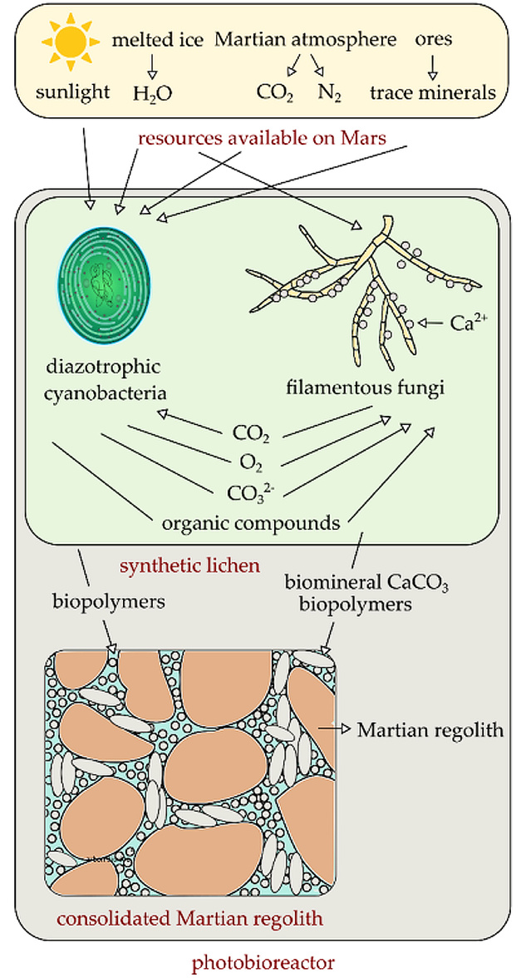
ANALYSIS
Cyanobacteria is able to grow on Mars regolith, and there is more EPS present meaning it is more likely to have an affect on the geological makeup and has more tolerant living conditions.
EPS present in non inoculated Mars Regolith may be due to cross contamination
Standard deviation bars show that amount of EPS present in Martian soils is very similar to the amount of EPS found in clay like soils on Earth, which have a similar texture.
Although EPS is able to help sand stick together better than clay like or martian like substances, due to the research of using cyanobacteria to stick Martian regolith together we can see that is can adjust the geological makeup.
diagram of using cyanobacteria and fungi as architectural building blocks on mars (4)

Slide 8
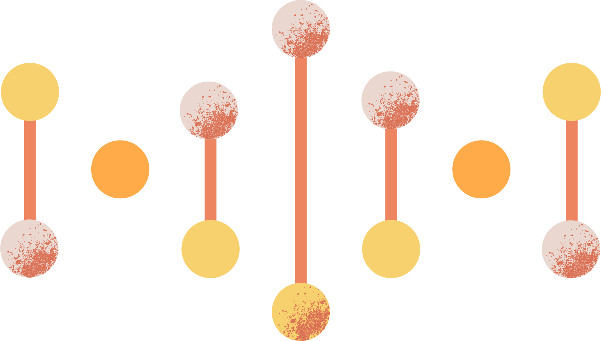
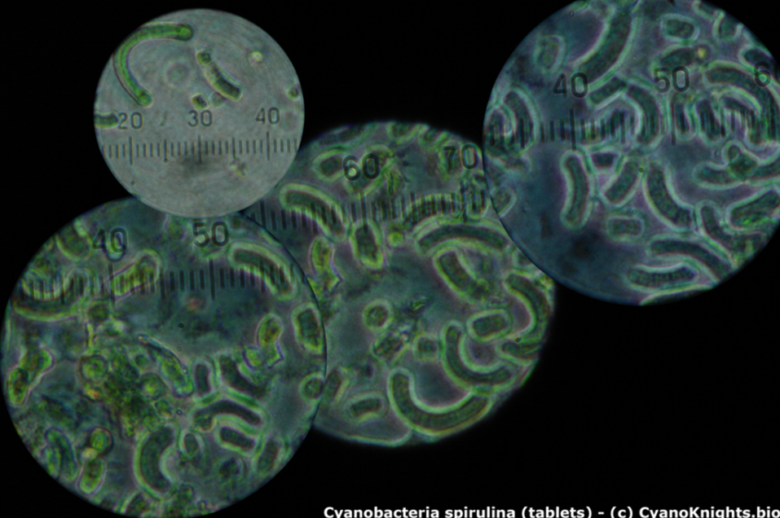
DISCUSSION AND FUTURE RESEARCH
The next step is to map where these biocrusts may have been, and test which Martian, or past Martian, environmental conditions best support the growth of cyanobacteria. In order to estimate when they may have evolved, or if it is plausible to bring cyanobacteria to Mars in the future.
Cyanobacteria are able to grow on Martian surface, as well as leave behind EPS. Evidence that there is a possibility of bio crust on Mars or past Mars.
microscope imaging of cyanobacteria (7)

Slide 9
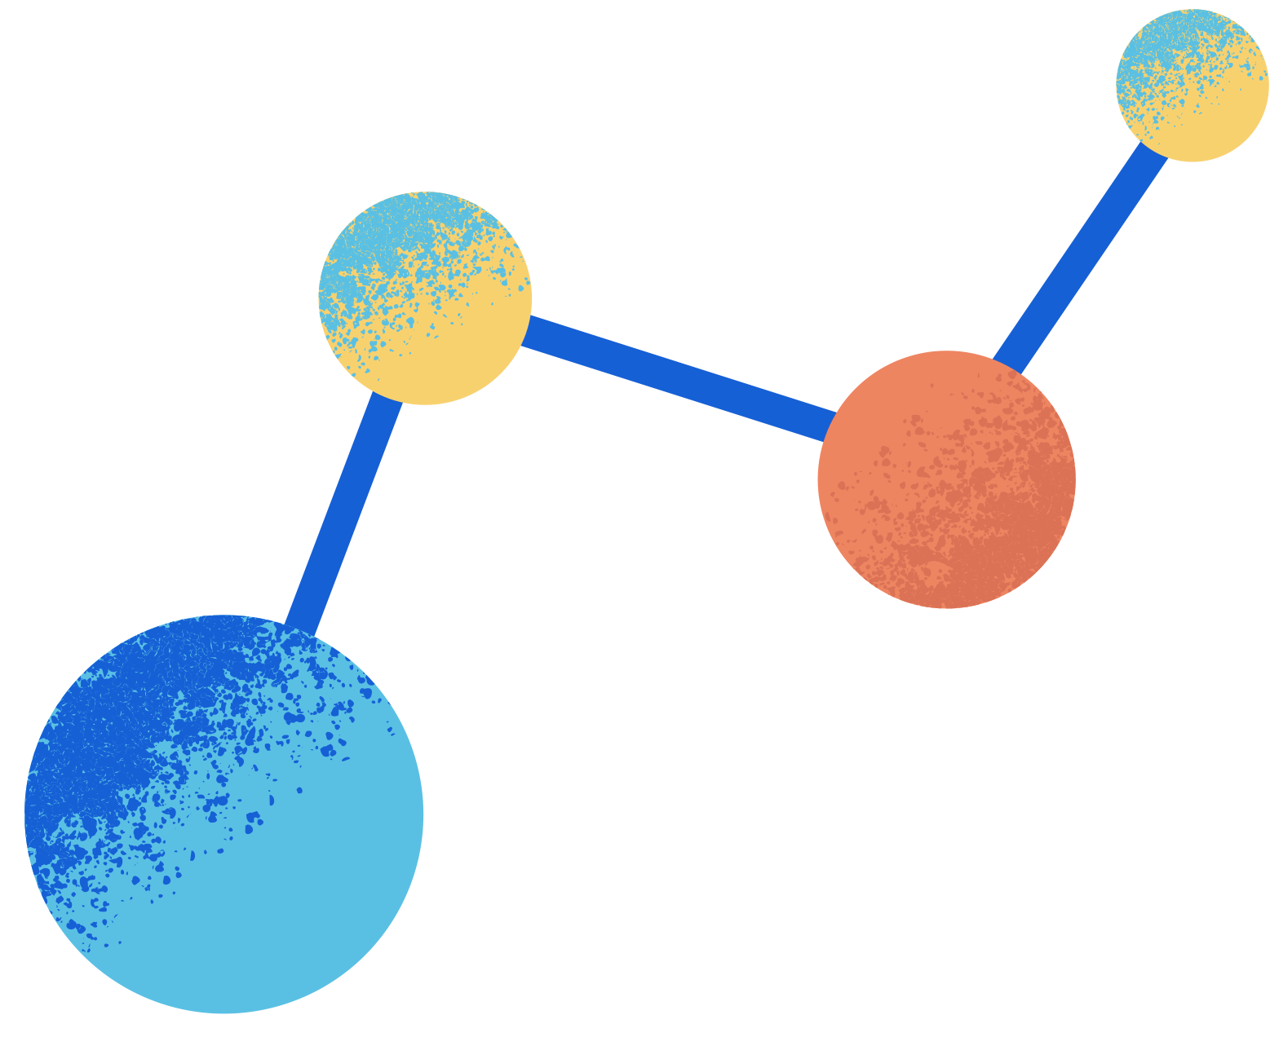
REFERENCES
Antoninka, A., Bailey, L., Charley, S. (n.d.). Chla extraction microplate reading. Northern Arizona University Department of Forestry. https://docs.google.com/document/d/1NYvbelCJKEH6UEEJyzYnMR1c62Augb5_MaBTj3lgekc/edit?tab=t.0
Blair, K. (2023). EPS sorting instructions. Northern Arizona University Department of Forestry. https://docs.google.com/document/d/1tWPKcb6pUH83vTDx0HfLQsEqtASi6M3F6qmG6hqsOH8/edit?tab=t.0
Foucher, F., Ammar, M.-R., & Westall, F. (2015). Revealing the biotic origin of silicified Precambrian carbonaceous microstructures using Raman spectroscopic mapping, a potential method for the detection of microfossils on Mars. Journal of Raman Spectroscopy, 46(10), 873–879. https://doi.org/10.1002/jrs.4687
Jin, C. (2023). Biomineralization-enabled self-growing building blocks for habitat outfitting on Mars, NASA. https://www.nasa.gov/general/biomineralization-enabled-self-growing-building-blocks-for-habitat-outfitting-on-mars/
Kumar, D., Kaštánek, P., & Adhikary, S. P. (2018). Exopolysaccharides from cyanobacteria and microalgae and their commercial application. Current Science (Bangalore), 115(2), 234–241. https://doi.org/10.18520/cs/v115/i2/234-241
Mishra, A. K., Tiwari, D. N., & Rai, A. N. (Eds.). (2019). Cyanobacteria : from basic science to applications. Academic Press, an imprint of Elsevier.
Nowakowski, T. (2014). Students aim to put cyanobacteria on Mars to generate oxygen, Phys.org. https://phys.org/news/2014-12-students-aim-cyanobacteria-mars-oxygen.html
Verseux, C., Baqué, M., Lehto, K., de Vera, J.-P. P., Rothschild, L. J., & Billi, D. (2016). Sustainable life support on Mars – the potential roles of cyanobacteria. International Journal of Astrobiology, 15(1), 65–92. https://doi.org/10.1017/S147355041500021X
Acknowledgements:
I would like to thank my mentor, Alicia Rutledge, for guiding me through this project and helping me make better decisions with my project and helping me become a better scientist. Kayla Blair for helping me with my research and training me, and Natalie Jones for providing me with the project and helping me with anything I need. Thank you to Anita Antoninka, and Matthew Bowker for letting me use the NAU DIRT labratory and greenhouse space for growing and analyzing the biocrusts. Thank you to Seth Charley and Lydia Bailey for training me. Thank you to the NAU PIXEL Lab for helping guide me through this project.

